Slide 1
eBAY Website
UNDER GUIDENCE OF VAISHALI MAM

Slide 2
Introduction
eBay is one of the world’s largest e-commerce platform which allows users to sell their products and customers to buy products.
eBay was founded by Pierrie Omidyar in California in 1995.
Initially it was named as ‘Auction Web’.
Goal: Test critical e-commerce functionalities by using Selenium and TestNG.

Slide 3
Overview
eBay provides many products including electronics, fashion and more.
Key Features:
User Login and Authentication
Product Search
Adding / Removing Items from Cart
Updating user details
Product categories
Language selection

Slide 4
Modules:
Module-1: SignIn Page
Entering Credentials
Validating login functionalities
Verifying for invalid credentials
Ensuring forget password link works properly
Module-2: Search Functionalities
Validating search results
Working of filter
Navigation of product pages from search

Slide 5
Module-3: Cart Functionalities
Adding products to cart
Verifying products details in cart
Removing items from cart
Module-4: Profile Name Update
Edit first and last name of profile
Verifying the data is updated
Module-5: Update Address
Updating address in the profile section
Verifying the data is updated

Slide 6
Module-6: Category Page
Checking every category
Verifying products on each and every category
Checking available sub-categories
Module-7: Change Language
Changing website language
Verifying language change

Slide 7
Defects
While running a testcase at certain point some fields are not working as it is expected, so I have created a defect report on these defects.

Slide 8
Defect Report:
Defect Identifier | Defc_eBay_01
Defect Summary | While logging in for several times it displays captcha page
Test Id | TC_07
Test Case Name | TC_login_03
Module Name | SignIn Page
Reproducible
Severity | Medium
Priority | Medium
Raised By | Srihari(Tester)
Assigned To | Development Team
Date of Assignment | 18-08-2025
Status | Open
Snap Shot
Fixed By | Siddu(Developer)
Date of Fixing
Approvals(Manager) | Kiran Kumar(Manager)

Slide 9
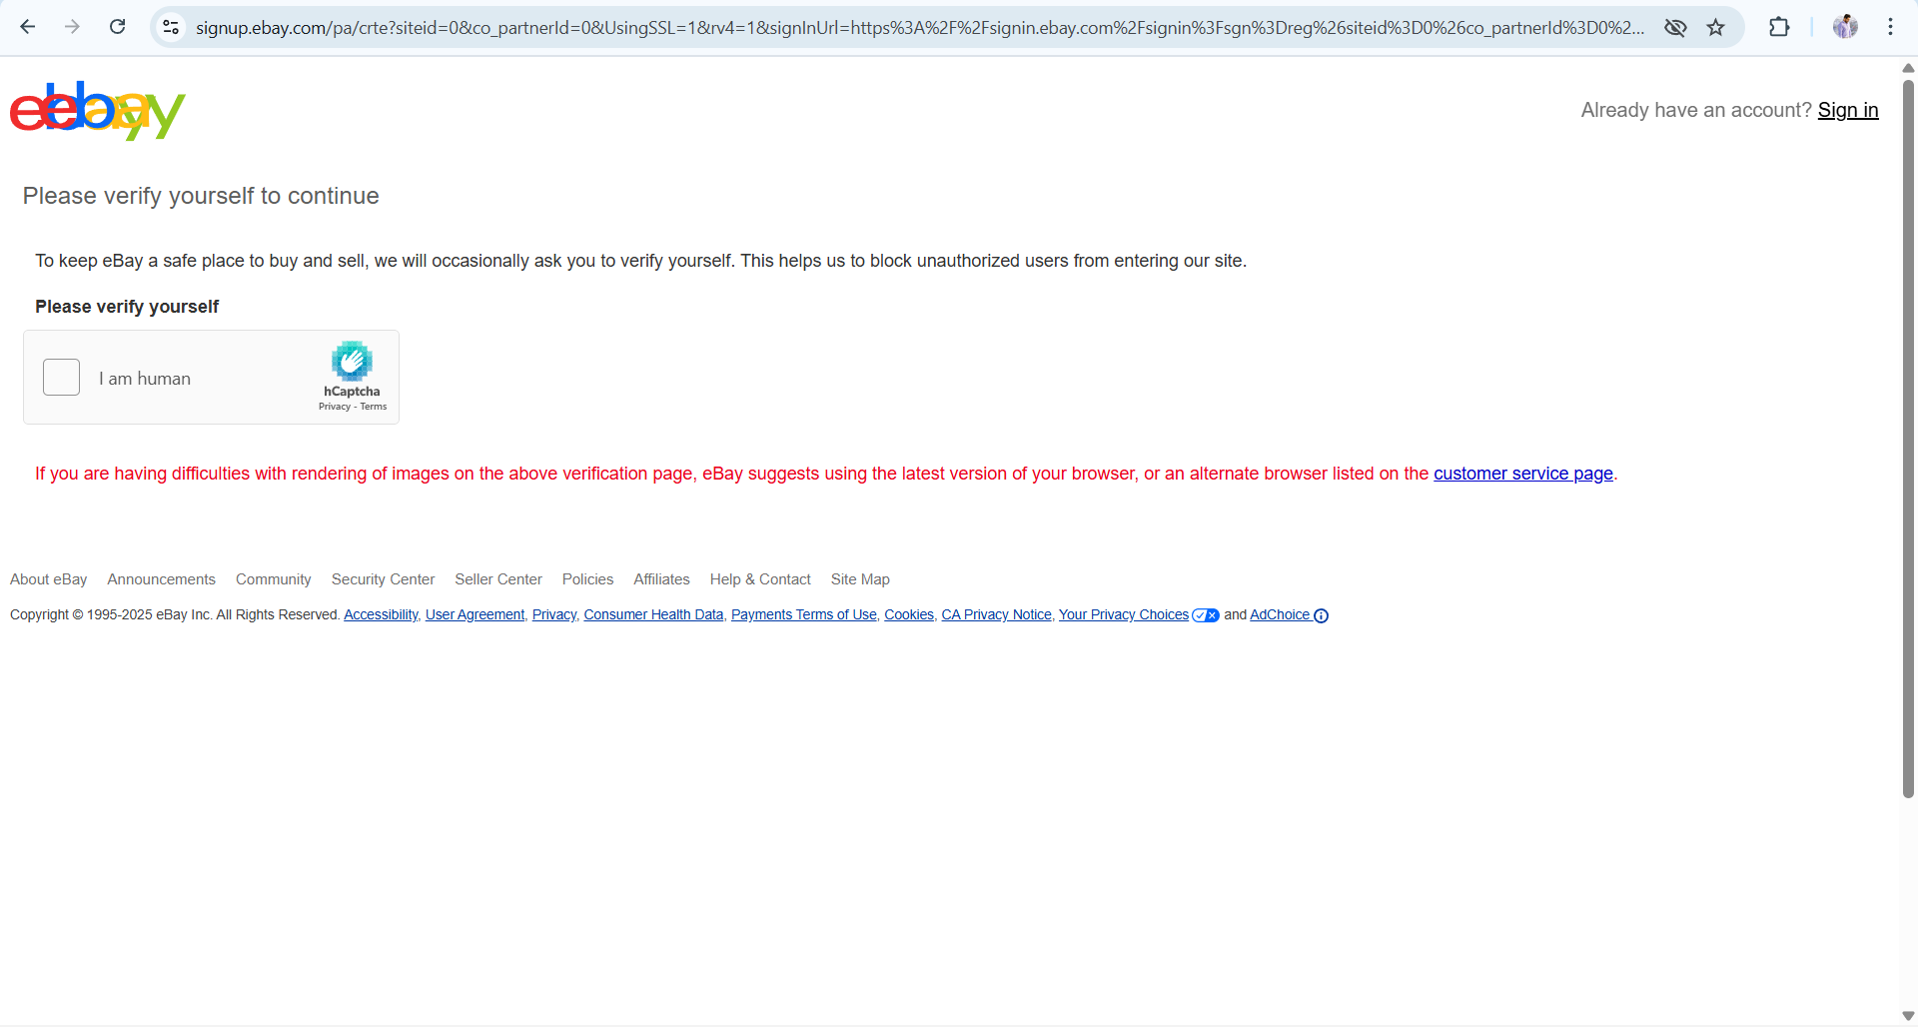
Snap Shot

Slide 10
Challenges:
While testing sign in page several times eBays uses captcha verification for preventing from ai-bots.
This will terminates test execution.

Slide 11
Experience
Gained hands on experience in automating web applications using Selenium Web Driver and TestNG.
Helps to find out bugs.
Gained experience on automation.

Slide 12
Thank You!!!

